Slide 1
Cloud Kitchen in City of Toronto
Coursera IBM Data Science Capstone Project
March 2020

Slide 2
Introduction
This is the final capstone project of my IBM Data Science Certified Professional offered by Coursera
A client is interested in setting up cloud kitchen in the city of Toronto.
He is looking to leverage his existing business and expand through cloud kitchen.
By providing recommendation for a suitable location, the client will be able to ideally build his cloud kitchen to expand his business.

Slide 3
Data
One main data that is used to solve this problem is the location data that is freely offered by FourSquare.
Other important data that was used in this project are the latitude and longitude values of each cities, data related to Toronto.
These were the data sources that were used to collect the above-mentioned data:
FourSquare Developer APIs
Torronto, Canada – Wikipedia

Slide 4
Methodology
This picture shows the high-level methodology involved in approaching this project:
The upcoming slides will talk more in details about each of the steps involved
Exploratory Analysis of 5 categories
Clustering analysis on specific City
Plotting the results in a map

Slide 5
Exploratory Analysis
From Foursquare, I am able to pull the names, categories, latitude and longitude of the venues. With this data, I can also check how many unique categories that I can get from these venues.
Then, I analyze each neighborhood by grouping the rows by neighborhood and taking the mean on the frequency of occurrence of each venue category. This is to prepare clustering to be done later.
Here, I made a justification to specifically look for “Middle Eastern restaurants”. Previously, when I ran the model, I was looking for “Iranian restaurants” but there are very few results (maybe due to Foursquare categorization) so I looked for the restaurants closest to Iranian cuisine taste (side note: Iranian food and Middle Eastern food are very similar in taste, so my justification is that if there are people who enjoyed Middle Eastern food, they likely are going to enjoy Iranian food too!)

Slide 6
Exploratory Analysis
Lastly, I performed the clustering method by using k-means clustering. K-means clustering algorithm identifies k number of centroids, and then allocates every data point to the nearest cluster, while keeping the centroids as small as possible.
It is one of the simplest and popular unsupervised machine learning algorithms and it is highly suited for this project as well.
I have clustered the neighbourhoods in Toronto into 3 clusters based on their frequency of occurrence for “Middle Eastern food”.
Based on the results (the concentration of clusters), I will be able to recommend the ideal location to open the restaurant.

Slide 7
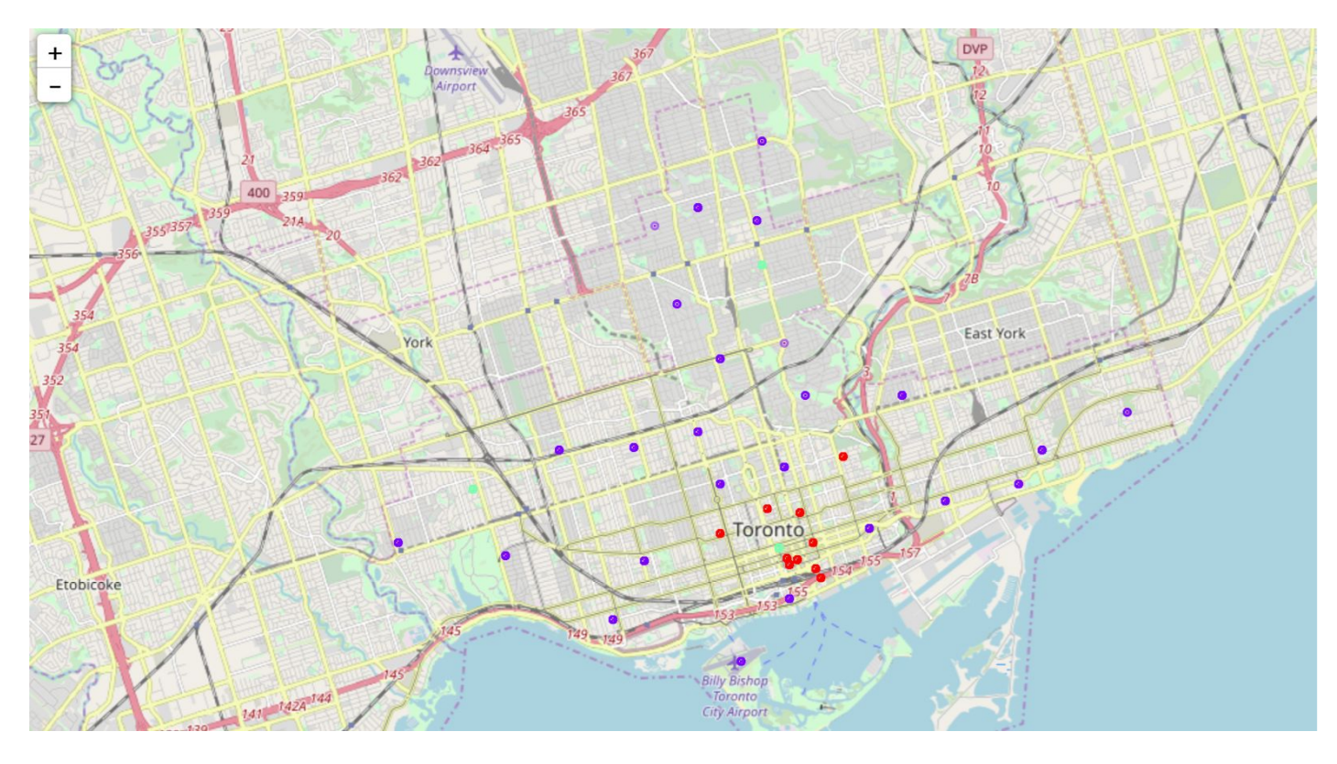
Results

Slide 8
Results
The results from k-means clustering show that we can categorize Toronto neighbourhoods into 3 clusters based on how many Middle Eastern restaurants are in each neighbourhood:
Cluster 0: Neighborhoods with little or no Middle Eastern restaurants
Cluster 1: Neighborhoods with some Middle Eastern restaurants
Cluster 2: Neighborhoods with high number of Middle Eastern restaurants
The results are visualized in the above map with Cluster 0 in red color, Cluster 1 in purple color and Cluster 2 in light green color.

Slide 9
Conclusion
Most of Middle Eastern restaurants are in Cluster 1 and 2 which is around Studio District, Garden District, Central Bay Street areas.
The lowest (close to zero) in Cluster 0 areas which are Adelaide, King, Richmond.
Also, there are good opportunities to open near Harbourfront East, Toronto Islands, Union Station as the competition seems to be low.
Looking at nearby venues, it seems Cluster 0 might be a good location as there are not a lot of Middle Eastern restaurants in these areas. Therefore, this project recommends the client to open an authentic Middle Eastern restaurant in these locations with little to no competition.

Slide 10
References
List of neighborhoods in Toronto: https://en.wikipedia.org/wiki/List_of_postal_codes_of_Canada:_M
Foursquare Developer Documentation: ​https://developer.foursquare.com/docs

